Slide 1
CS3003: Lecture 1
Welcome, Introduction, and Preliminaries

Slide 2
Learning Objectives
By the end of class today, you will be able to
navigate the format and mechanics of the class;
define (high-level) programming language and the three principles of program-language design (syntax, names and types, and semantics)
explain why studying programming languages is important;
describe the relationship between application domains and programming languages; and
define the key characteristics of the four programming paradigms.

Slide 3


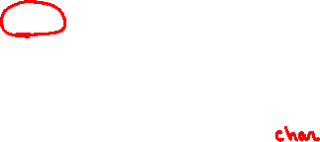
HWOTD: C++
#include <iostream>
int main() {
std::cout << "Hello, World\n";
return 0;
}

Slide 4
Semester Overview
Preliminaries
Imperative Programming (Python)
Object-Oriented Programming (Java)
Strongly-typed Pure Functional Programming (Haskell)
Logic Programming (Prolog)
Concurrency in Programming Languages (Go)
Syntax and Grammars

Slide 5

Weekly Overview
Sunday | Monday | Tuesday | Wednesday | Thursday | Friday | Saturday
 | 12:00pm – 1:00pm: Office Hours (in person and virtual) | 1:20pm – 2:35pm: Class | 12:00pm – 1:00pm: Office Hours (in person and virtual) | 1:20pm – 2:35pm: Class | 12:00pm – 1:00pm: Office Hours (in person and virtual)

Slide 6
Daily Overview
HWOTD
Questions/Review
New Material
Recap

Slide 7
Assessment Overview
Participation (5%)
Quizzes (20%)
Assignments (40%)
Tests (20%)
Project (15%)
Extra Credit!

Slide 8
Assessments: Participation
Participation
5% of your final grade.
No more than 3 unexcused absences.
Keep up with your QDD.
Quizzes
Assignments
Tests
Project
Extra Credit!

Slide 9
Assessments: Quizzes
Participation
Quizzes
8 quizzes throughout the semester.
"Retakable" 2 times before the deadline – only the highest score will count!
20% of final grade and no late quizzes are accepted.
Assignments
Tests
Project
Extra Credit!

Slide 10
Assessments: Assignments
Participation
Quizzes
Assignments
4 assignments throughout the semester.
40% of the final grade; you will lose 10% for every day that you are late submitting an assignment.
Tests
Project
Extra Credit!

Slide 11
Assessments: Tests
Participation
Quizzes
Assignments
Tests
There is a midterm and a final; these will be taken in class.
They are going to be open book.
20% of your final grade.
Project
Extra Credit!

Slide 12
Assessments: Project
Participation
Quizzes
Assignments
Tests
Project
20% of your final grade.
Group project.
Three steps:
Choose a topic related to PL that interests you.
Research that topic.
Create and record a 5-minute lecture.
Extra Credit!

Slide 13
Assessments: Extra Credit!!
Participation
Quizzes
Assignments
Tests
Project
Extra Credit!
3% boost!
HWOTD

Slide 14
Very Important
Health
Diversity, Equity and Inclusion
Student Success

Slide 15

Programming Languages
What the heck is a programming language?
What are the fundamental components of a programming language?

Slide 16
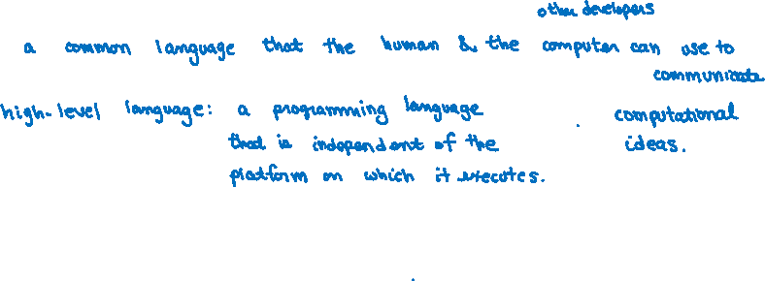
Programming Languages
A programming language is …

Slide 17
Programming Languages
A programming language is made up of …

Slide 18
The Value of Studying PLs
There must be some reason we have to take this course, right?

Slide 19
Programming Domains
We write programs to solve real-world problems.

Slide 20
Programming Paradigms
Classifying languages into buckets
Imperative
Object-oriented
Functional
Logic

